Slide 1
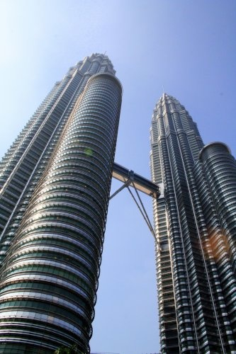
The Challenge
Of Asia’s Urban Aggregations

Slide 2

World’s 10 Largest Cities
1. Tokyo/Yokohama Japan 33,200,000
2 . New York Metro USA 17,800,000
3 Sao Paulo Brazil 17,700,000
4 Seoul/Incheon South Korea 17,500,000
5 Mexico City Mexico 17,400,000
6 Osaka/Kobe/Kyoto Japan 16,425,000
7 Manila Philippines 14,750,000
8 Mumbai India 14,350,000
9 Delhi India 14,300,000
10 Jakarta Indonesia 14,250,000

Slide 3
Growth Of Cities
Rome -the first settlement to reach 1 million
Only in 1800 did London become the second city to reach this population size.
In 1800, only 2 per cent of the world’s population was urbanised.
By the year 1900 - only 15 percent of the population, about 250 million, lived and worked in urban areas
By the year 1950 - 30 per cent
By the year 2000, 2.8 billion people lived in urban areas equaling approximately 49 percent of the world's population.
2030 – estimated urbanisation 60% (3.7 billion)
Interactive map (from a BBC report) http://news.bbc.co.uk/2/hi/in_depth/world/2006/urbanisation

Slide 4
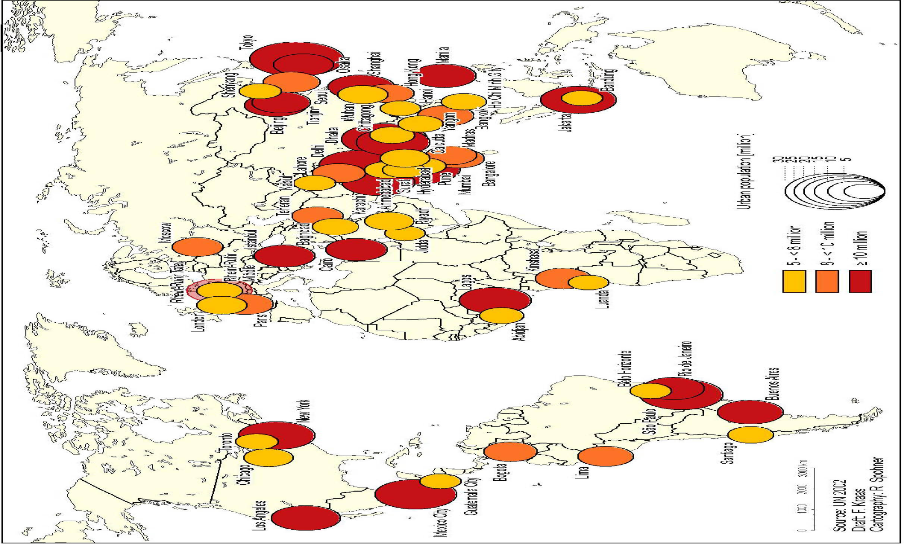
World’s Megacities 2015

Slide 5

Asia’s Explosive Growth!
61 per cent of the global population lives in Asia. Asia has more than half of the cities that have more than 10 million people
Percentage of urban population: 9 per cent in 1920, 48 per cent in 2000 and projected to be 53 per cent by 2030.
Many Asian cities double their population every 15 to 20 years. Whereas London took 130 years to grow from 1 to 8 million, Bangkok took 45 years, Dhaka 37 years and Seoul only 25 years.
By 2015, Asian developing countries will hold three of the world’s five largest urban agglomerations: Mumbai, Dhaka and Delhi.
Dhaka, a mere 417,000 inhabitants in 1950, is now 12.5 million inhabitants. Within a decade - 22.8 million people.

Slide 6
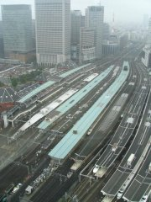
Mega Urban Regions
It is expected that, by 2020, two-thirds of the entire Association of East Asian States (ASEAN) urban population will live in only five Mega-Urban-Regions (MURs)
Bangkok-centred MUR (30 million)
Kuala Lumpur–Klang MUR (6 million)
Singapore Triangle (10 million)
Java MUR (100 million)
Manila MUR (30 million).
East Asia:
Tokyo–Osaka–Kyoto–Kobe–Nagoya MUR (60 million), Hong Kong–Shenzen–Guangdong MUR (120 million) and Greater Shanghai MUR (83 million).

Slide 7
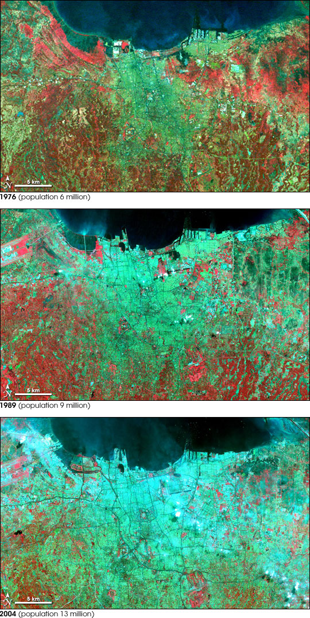
Urban Growth In Jakarta
NASA image –
light green areas = developed areas, red area = vegetation
Top image – 1976
population = 6 million
Center – 1989
population = 9 million
Bottom – 2004
population = 13 million

Slide 8
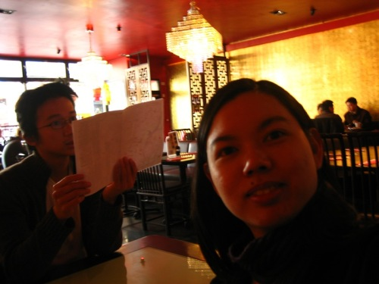
Urban Growth In China
• One quarter of the world’s 500 largest urban areas are in China
• 2050: China’s urban population will increase by 300-700 mil.
• 2002 urbanization : 36%
• 2050 urbanization rate: 70%
• US (2000): 77%
• Japan (2000): 79%
• Germany (2000): 88%
Urban Growth in China: Challenges and Prospects
Karen C. Seto, Department of Geological and Environmental Sciences and
Freeman Spogli Institute for International Studies Stanford University

Slide 9
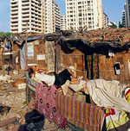
Slums
About half of the world’s 1 billion urban slum dwellers live in Asia and the Pacific.
In 2001, 38 per cent of the region’s 3.7 billion people were living in urban areas, with 43 per cent of its 1.2 billion urban residents living in slums.
India and China alone accounted for 65 per cent of the overall Asian urban slum population.
The region’s group of least developed countries had an urban slum incidence of about 72 per cent, about 30 per cent more than the regional average.

Slide 10
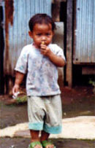
Focus On Poverty
. that they have no time for the sophisticated constructs of economy and environment. . . on acid rain and water pollution and storage of radioactive waste and all of the classic western environmental issues from recycling on. . . . For them the crux of the debate is how you deal with poverty in human settlements and that’s all there is to it. Everything is focused on the poor, whether it’s water or sewage or disease or waste, or population growth. All of these are products of poverty. Everything else is academic, and I must say I agree completely
(Stephen Lewis 1992)

Slide 11

Urban Migration
Movement from rural areas to the cities is around 3.5% per year
China alone is expected to see 300m-500m people move to cities by 2020 (greater than the population of Europe)
Chongqing - 10 million new arrivals
India tries to slow urban migration whereas China tends to accept it.

Slide 12
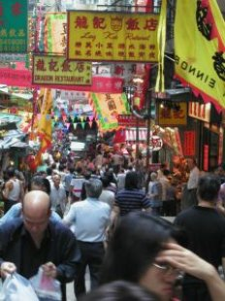
Changing Roles For Urban Migrants
Women may lose their traditional roles as gardeners and as part of the village matrix
Men may go to the city and be separated from their families, work can be uncertain and underpaid
Young men may not have a clear role and can end up in crime
Young women are vulnerable to violence and sexual exploitation
The elderly may not feel comfortable in an urban setting
Yet Asian cities are twice as safe as African or South American cities

Slide 13

A Young Population
Urban Population (India):
Age structure:
0–14 years: 30.8%,
male: 188,208,196, female: 171,356,024
15–64 years: 64.3%,
male: 386,432,921, female: 364,215,759
65+ years: 4.9%,
male: 27,258,259, female: 30,031,289 (2007 est.)
The average age of Indians is 24.8 years. (2001 Census Data)

Slide 14
Highly Aspirational
People who move to cities tend to be young and highly aspirational
They want to achieve
They want to be ‘modern’
They want to connect to the West - and to their families at the same time.
The cellphone, the car and the condo are part of the dream
Many want to learn English and to join the global economy

Slide 15
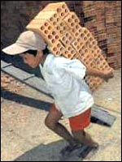
Problems Of Urban Migration
Inadequate Infrastructure – housing, roads, garbage disposal, sewage etc
Pollution / Environmental
Exploitation
Unemployment
Creation Of Slums
Violence
Lack Of Community
Addiction
Broken Family Structures

Slide 16
Opportunities Of Urban Migration
Billions with TV, radio and cellphones
Massive concentrations of people within a single broadcast area
Increase in the use of major languages, less need to broadcast / translate into tribal languages
Displacement can, in some circumstances, lead to greater spiritual openness.

Slide 17

Gateway Cities
Asia has 57 of the top 100 Gateway Cities in the 10-40 Window (as identified by the AD2000 and Beyond movement)
A ‘gateway city’ is a strategic city much like Ephesus in the NT, that when penetrated with the gospel will become a doorway to surrounding people groups
See handout for list of gateway cities in Asia

Slide 18

Bye, Bye Parish Church
As people use cars and public transport to select the church they will attend the rural parish church is often replaced by the mega-church, house church or the networked church.
Denominational loyalty gives way to convenience, easy parking and child care facilities
People come from a ‘teardrop’ shaped neighborhood within driving / taxi distance of the church
Church neighborhood may change rapidly and so the church may move to keep its character

Slide 19

Sector-Based Ministries
In the rural parish church the pastor ministered to whole families and would visit them at home
In the urban church pastors minister to sectors – youth, singles, marriage ministry, the aged etc
Visiting parishioners is relatively rare because of transport
Email groups and web sites are, in some cases helping churches to partly develop a sense of lost community

Slide 20

Lost Sheep
The ‘sheep’ tend to be less known as individual persons and to drop out between sectors e.g. changing from the singles to young married life or from school to university.
The challenges of university and college life cause some middle-class Asians to lose their faith
The violence of slums, gang warfare and drugs is also a very significant problem
Personal discipleship ministries, apologetics ministries, and ‘rescue missions’ are more needed in the urban environment

Slide 21

Evangelizing Asia’s Mega Cities
Going door to door on a bicycle will not work
Need mass communication to pre-evangelize the audience
Personal communication to disciple them later
Focus on the felt spiritual needs and aspirations of the target group
Frequent, brief, highly relevant messages
Homogenous Unit Principle – urban migrants seek out their own kind of people, food and culture

Slide 22
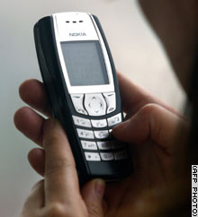
Media Ministries
People may stay loyal to a media ministry while changing churches and even while having time away from a traditional church
Loyalty to a brand
Developing a ‘brand’ that speaks to the urban environment and which retains loyalty
Complementary with the function of local churches where they do exist
Pre-evangelistic where they do not exist.
Some (of the worst) slums are media dark but many have extensive cellphone coverage and some have 90% TV and radio coverage.

